Slide 1




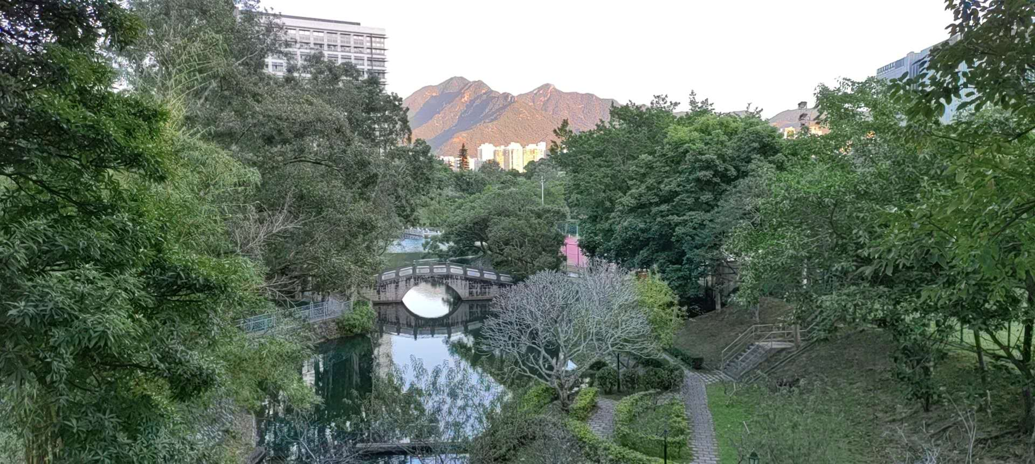
Lecture 2: Network Pruning
Feng-Lei Fan (FAN: Frontier of Artificial Networks)
Assistant Professor, City University of Hong Kong

Slide 2
Acknowledgement
These slides contain materials developed by
Song Han: https://www.dropbox.com/scl/fi/2oxmtvoeccyuw47yfambb/lec03.pdf?rlkey=3ykm0g21ibsoqn7xnw43v7aaw&e=1&dl=0
Bei Yu:
https://www.cse.cuhk.edu.hk/~byu/CMSC5743/2021Fall/slides/Lec03-pruning.pdf
Outline

Slide 3
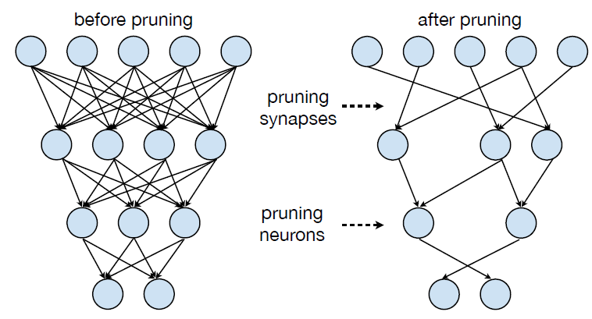
Pruning Overview
Outline

Slide 4
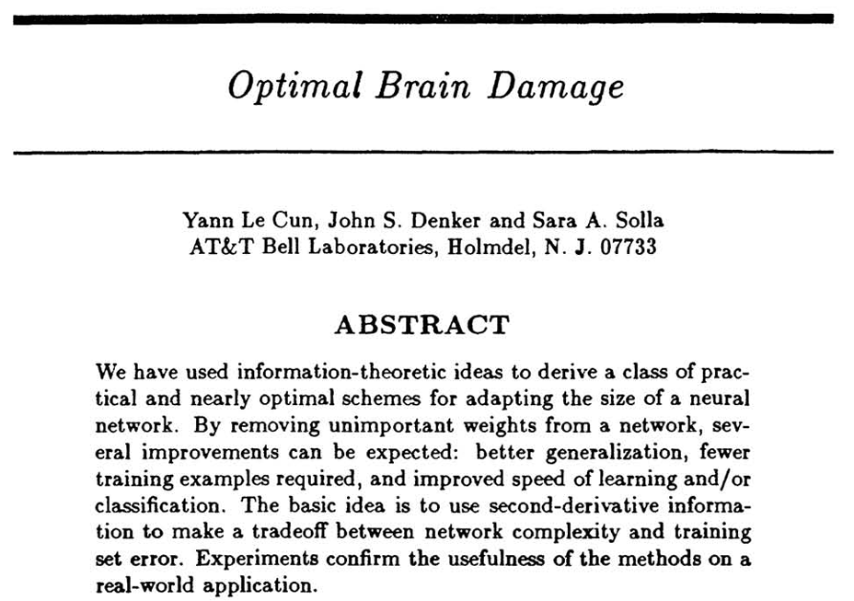
Early Paper

Slide 5
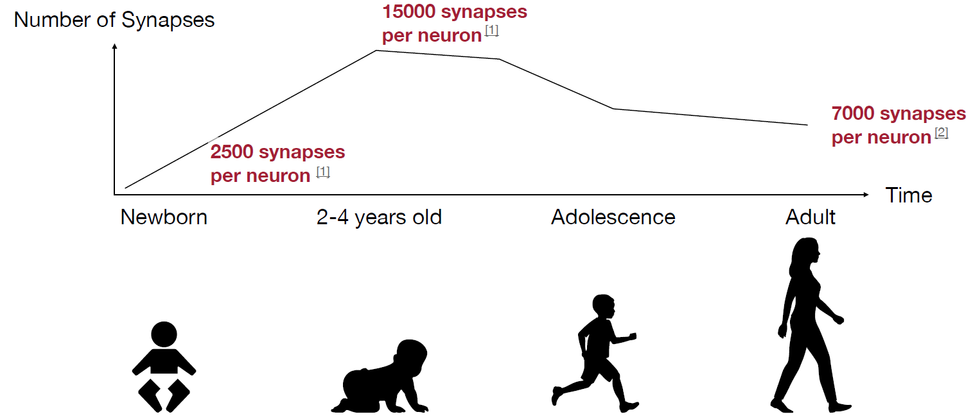
Pruning Happens in Human Being

Slide 6
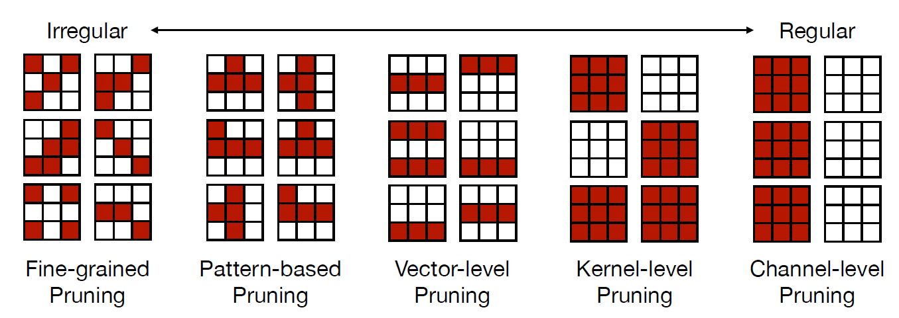
Pruning at Different Levels

Slide 7
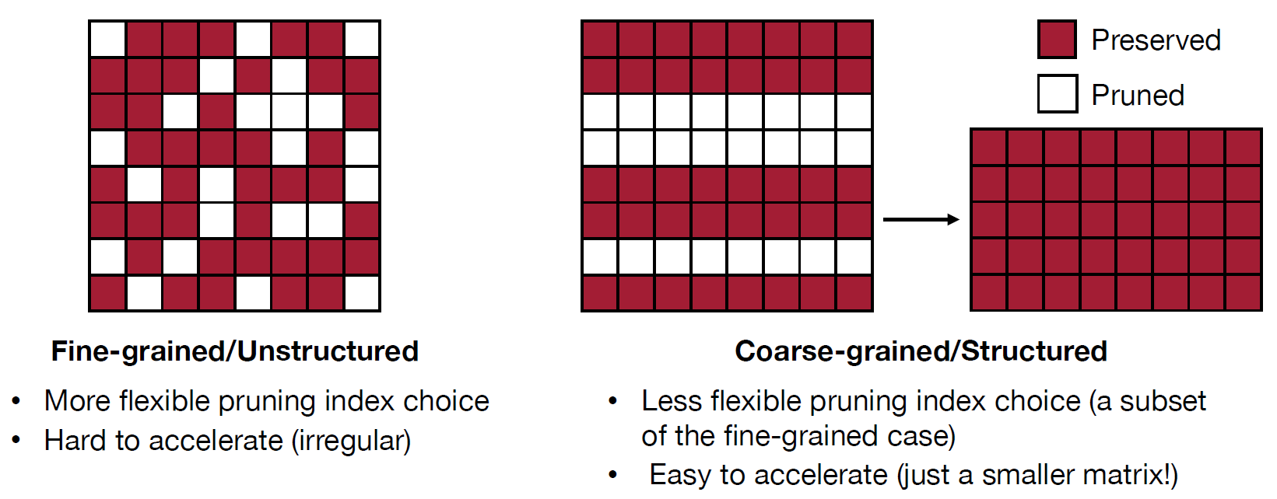
Pruning at Different Levels

Slide 8
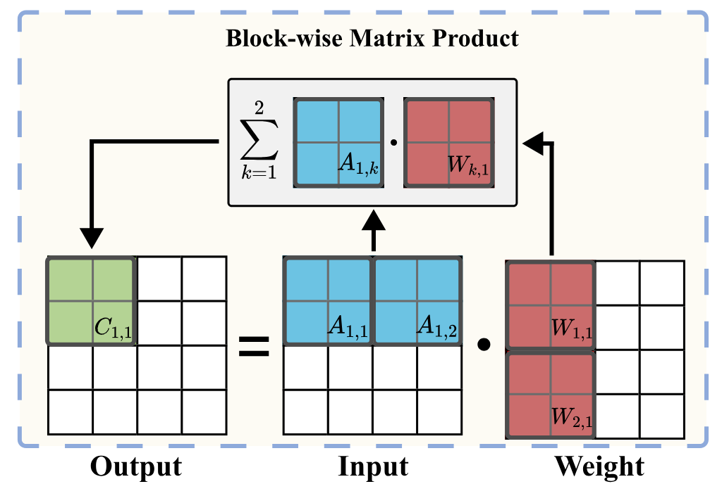
GPU Acceleration Mechanism

Slide 9
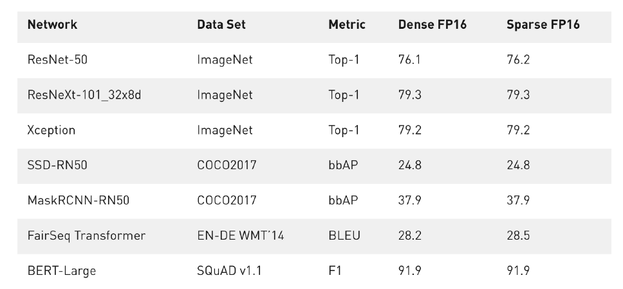
Pruning Can Reduce Over-fitting

Slide 10
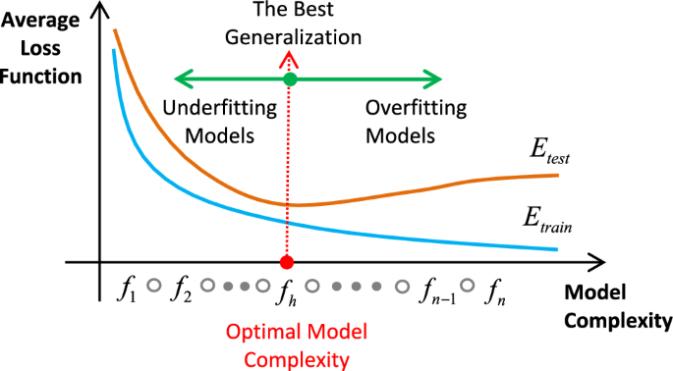
Pruning Can Reduce Over-fitting

Slide 11
Outline
Naïve Pruning
Optimization-based
Advanced Topics
Outline

Slide 12
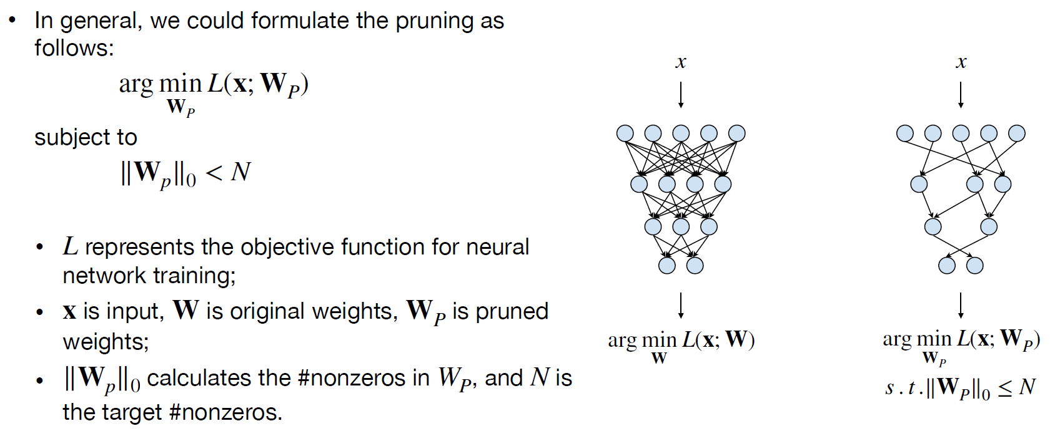
Formulation of Pruning

Slide 13
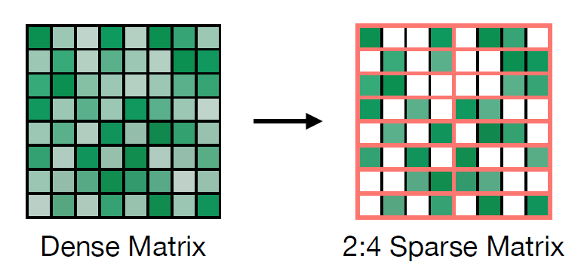
Compression Ratio of Pruning

Slide 14
Naïve Pruning
Determine the importance
Pruning

Slide 15

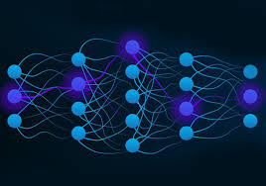
Importance Measure
Magnitude
Scaling
Gradient
Mutual Information
…
Outline

Slide 16
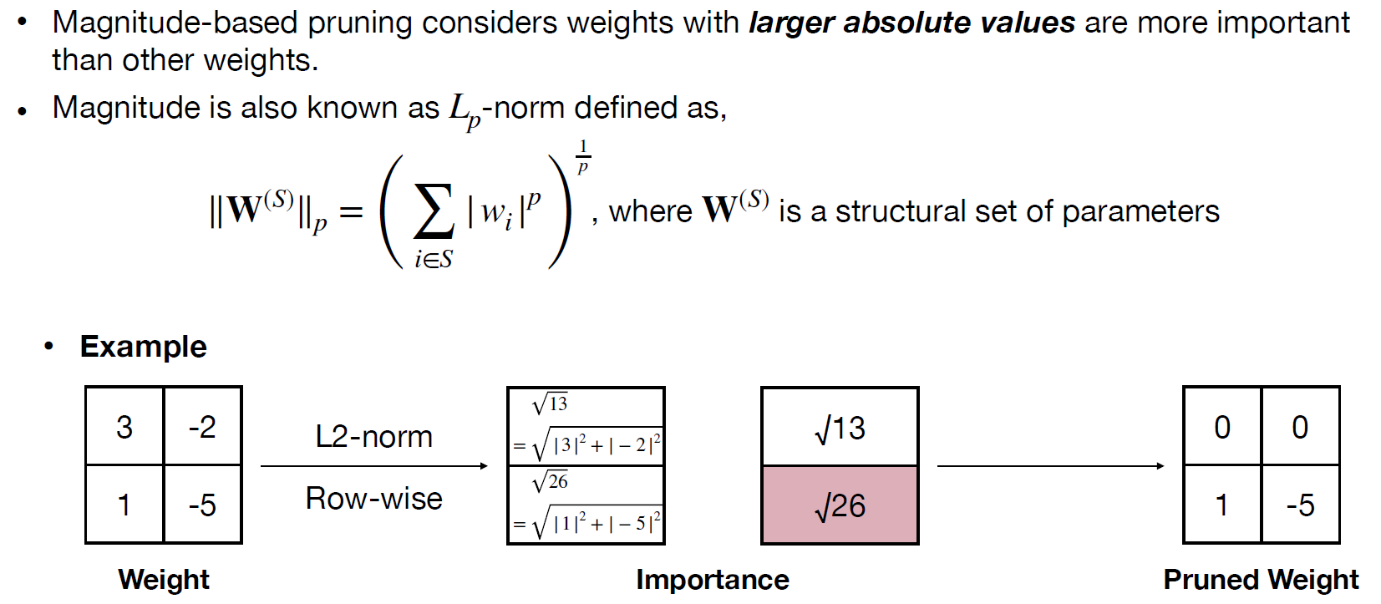
Magnitude

Slide 17
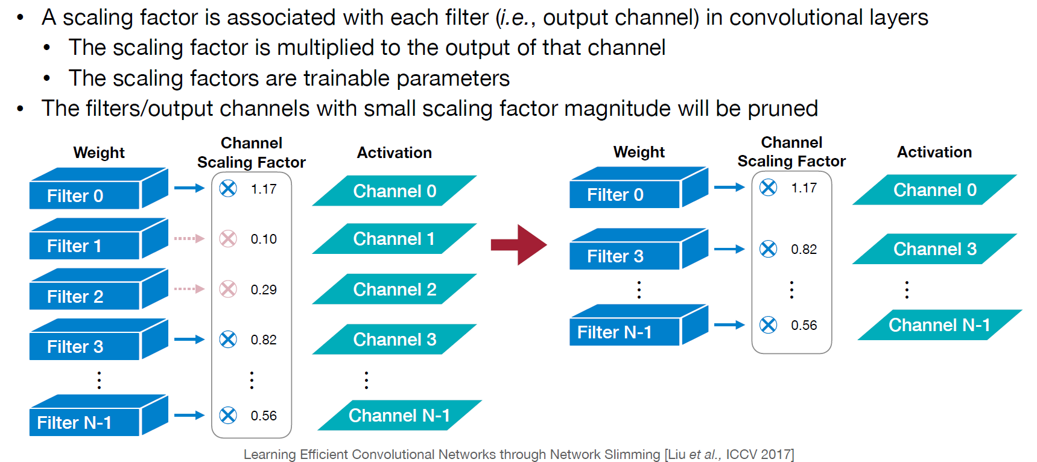
Scaling

Slide 18
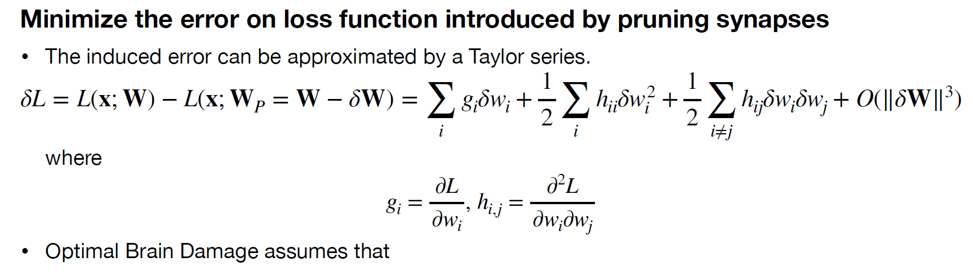
Gradient

Slide 19
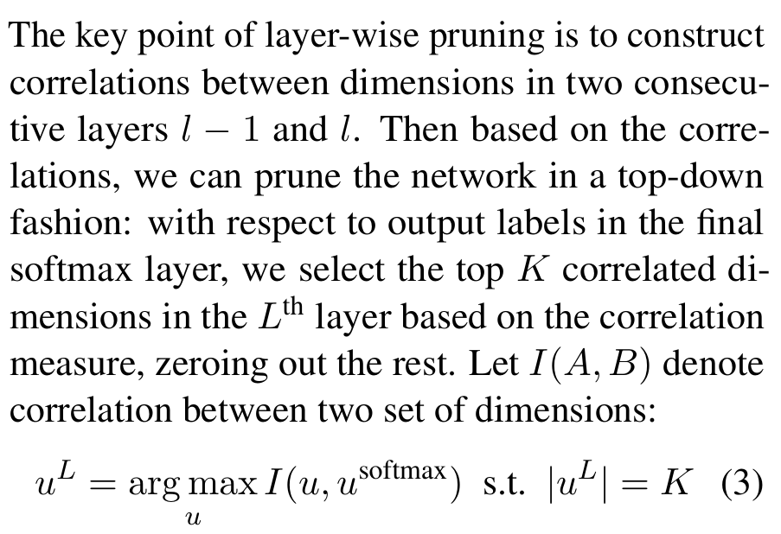
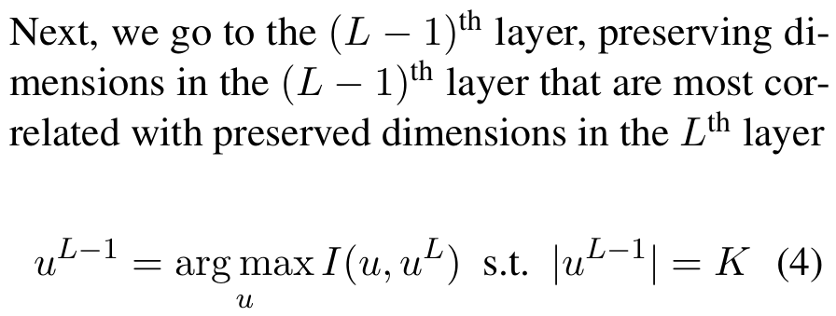
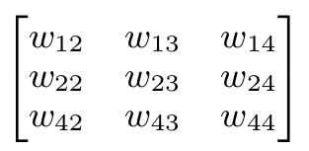
Mutual Information

Slide 20
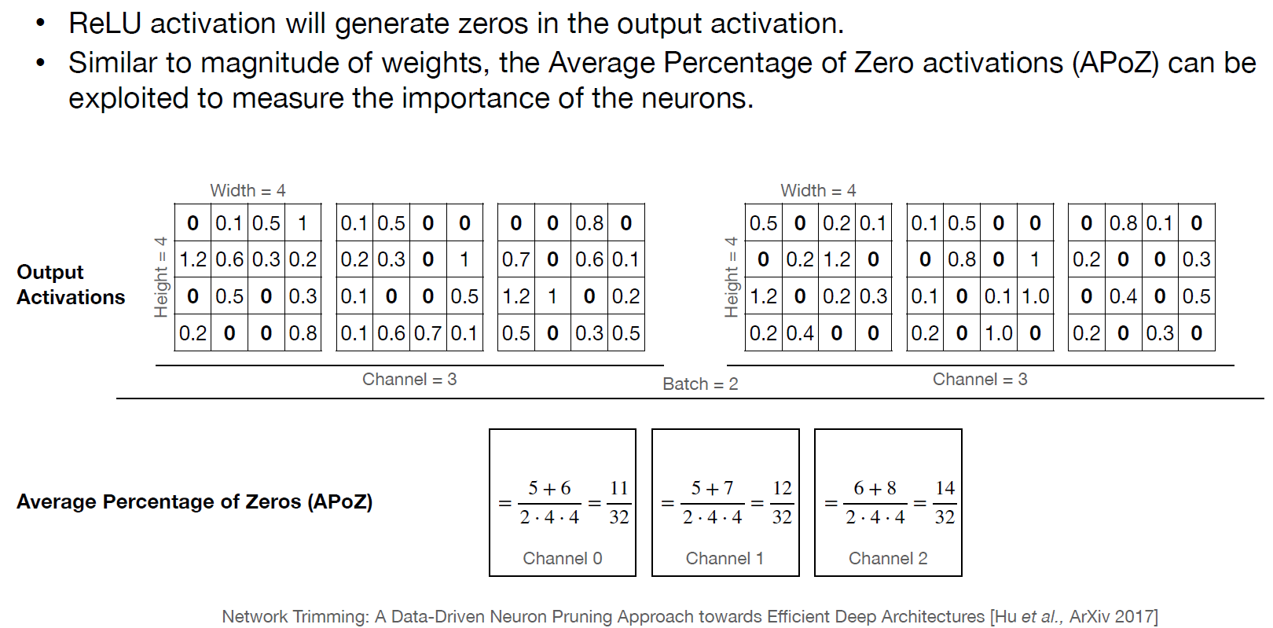
Percentage-of-Zero

Slide 21
Outline
Naïve Pruning
Optimization-based
Advanced Topics
Outline

Slide 22
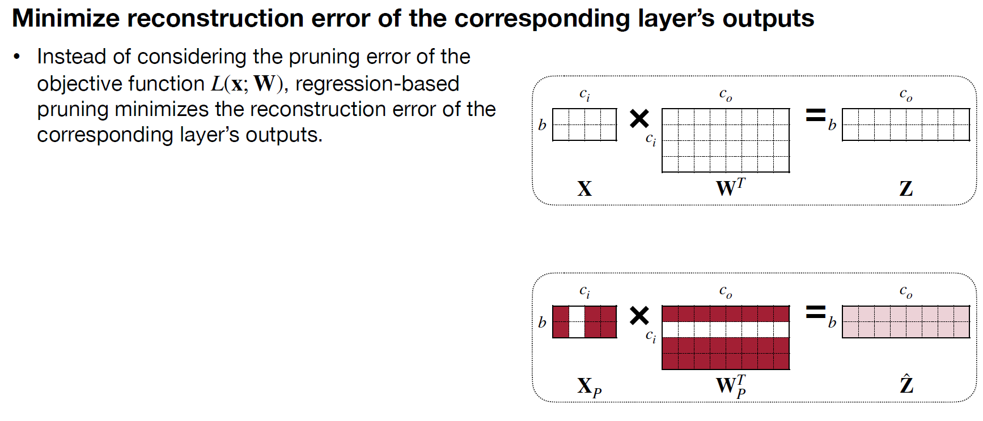
Optimization-based Pruning
Applies to fully-connected networks, CNNs, etc.!

Slide 23
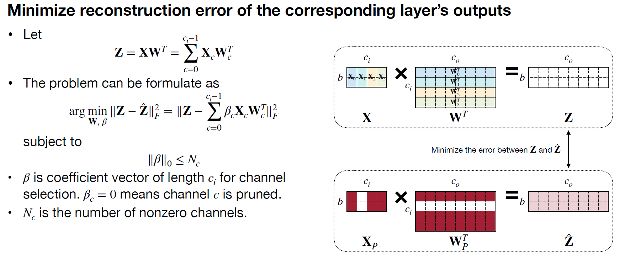
Optimization-based Pruning

Slide 24
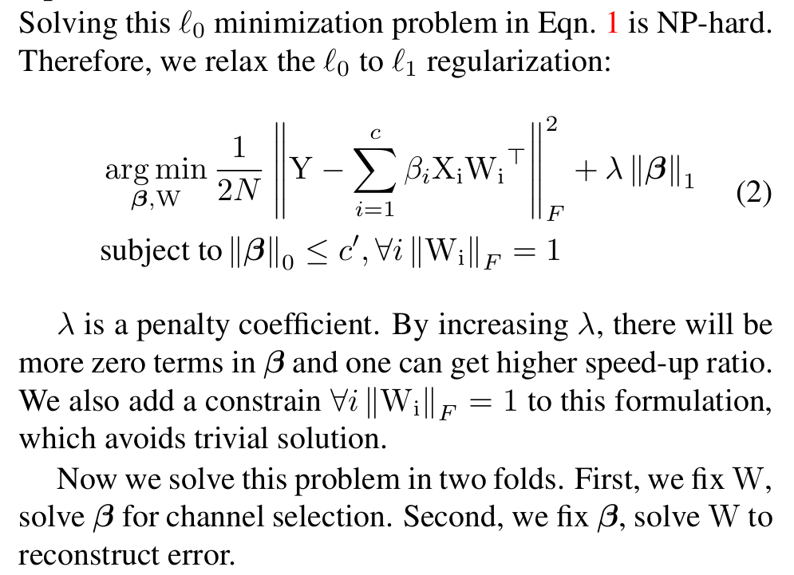
Solving

Slide 25
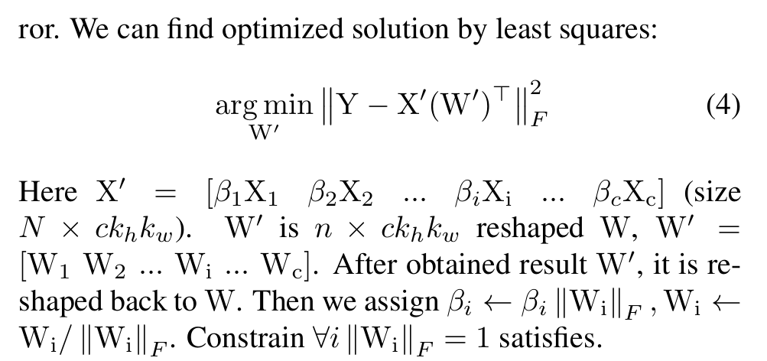
Solving: Least Square

Slide 26
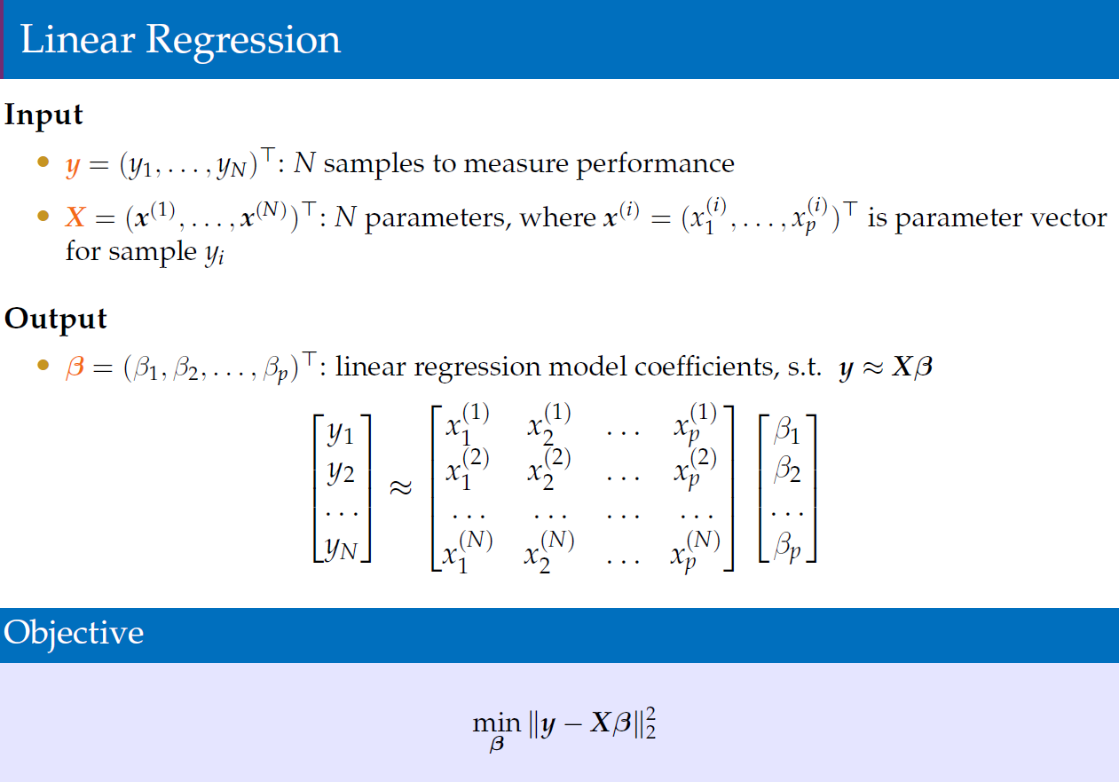
Solving: Least Square

Slide 27
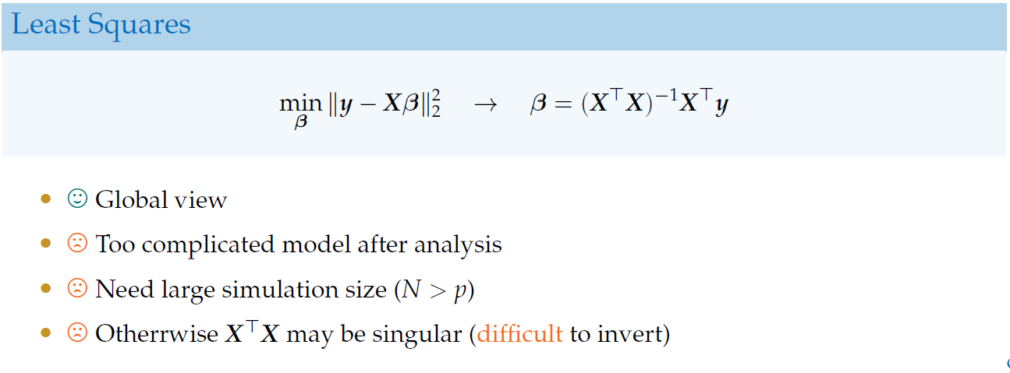
Solving: Least Square

Slide 28
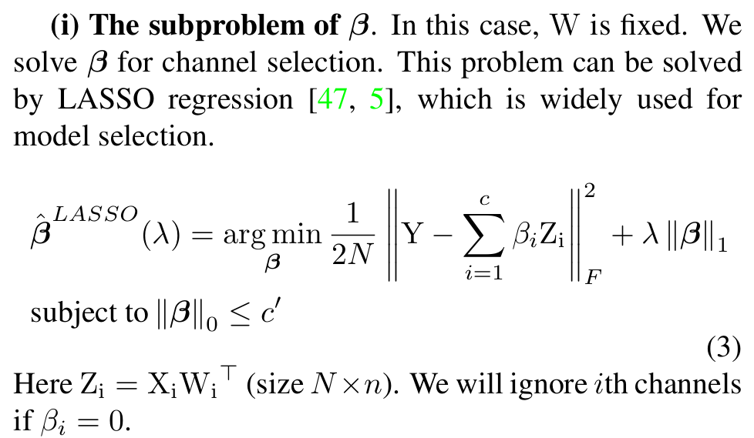
Solving: LASSO

Slide 29
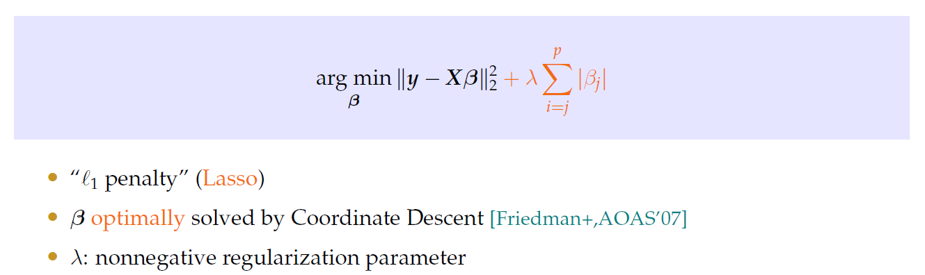
Solving: LASSO

Slide 30
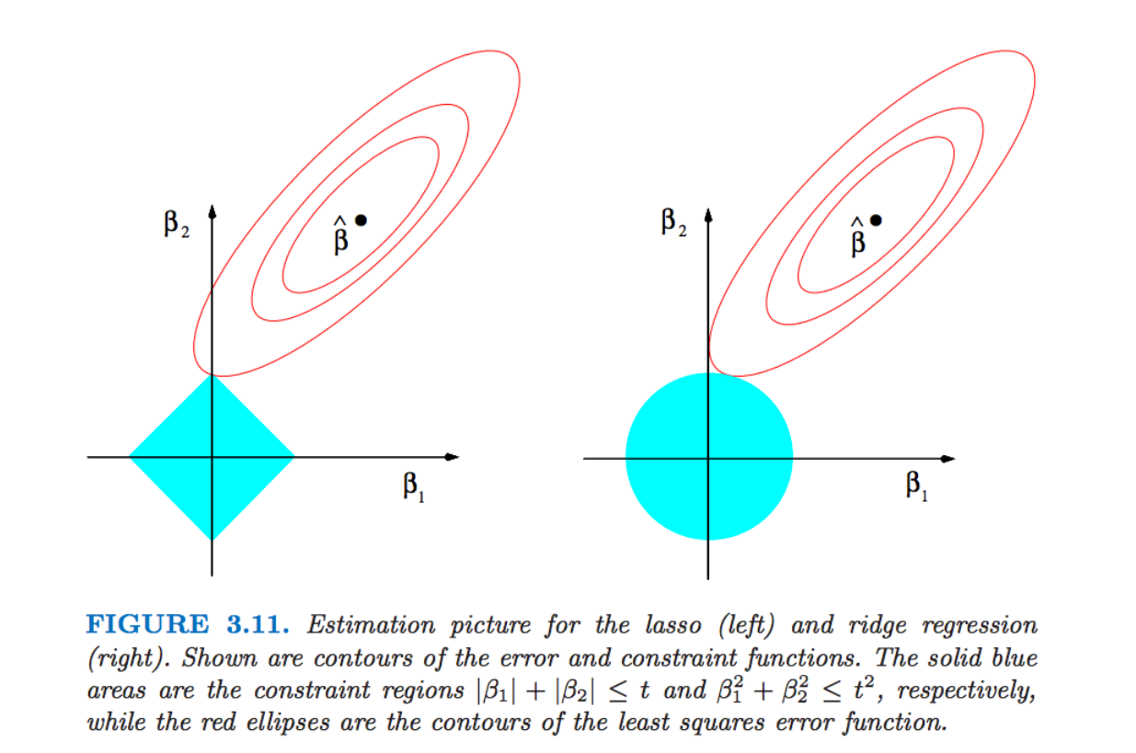
Solving: LASSO

Slide 31
Critiques
Bias in data
2. Longer time, even slower than training

Slide 32
Outline
Naïve Pruning
Optimization-based
Advanced Topics
Outline

Slide 33
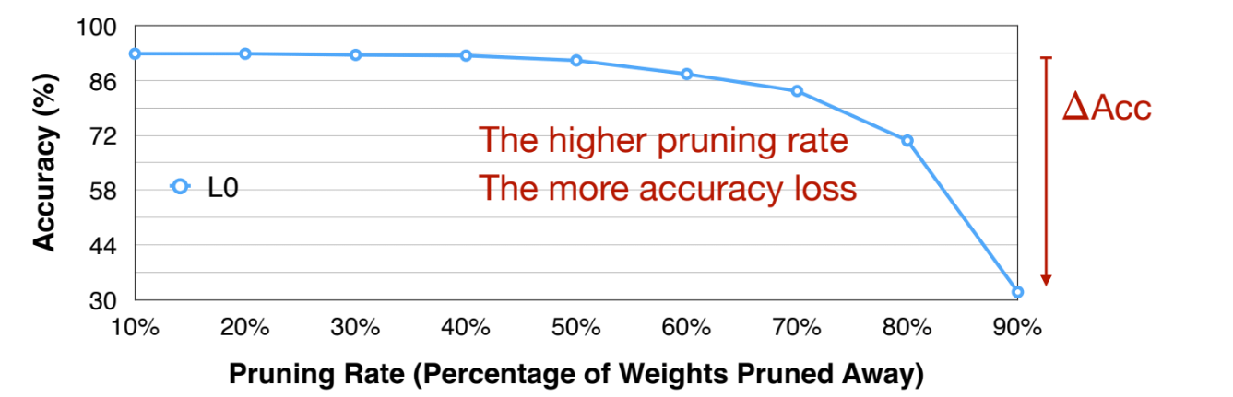
Analyzing Pruning Ratio

Slide 34
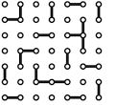


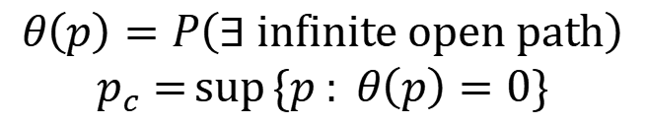

Mathematical Analysis of Pruning
Theoretical Basis (Percolation Theory)
$$θ\left(p\right)$$
1
Pruned
$$p_{c}$$
1
Planar graphs
Percolation
Phase transition
Probability $p$ open (not pruned)
$$θ\left(p\right)=P\left(∃ infinite open path\right)$$
$$p_{c}=\sup{\{p : θ\left(p\right)=0\}}$$
At least $p_{c}×100\%$ edges should be retained!

Slide 35
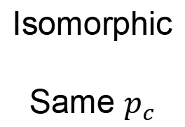






Mathematical Analysis of Pruning
Estimate Upper Bound of $p_{c,r}$, $r=2$
$$G_{r}$$
1D CNN
$$G_{2}$$
Planar graph
Isomorphic
Same $p_{c}$
$r$ nodes
……
$$p_{c,r}$$
$$p_{c,2}$$
$$p_{c}=0.5$$
At most 50% of edges can be pruned!

Slide 36

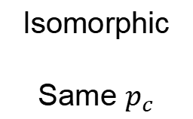







Mathematical Analysis of Pruning
Theoretical Basis (Percolation Theory)
Non-planar graph – upper bound
$$G_{r}$$
$$G_{−1}$$
Triangle
…
…
…
…
…
…
…
…
…
…
…
…
Isomorphic
Same $p_{c}$
More edges
Maintain
Probability
$$p$$
$$p^{2}$$
$$p$$
$$p$$
$$p_{c,r}$$
$$p_{c,−1}$$
$p_{c, triangular}≥p_{c,−1}≥\frac{1}{μ_{r}}$
At most $(1−p_{c,r})×100\%$ edges can be pruned!

Slide 37
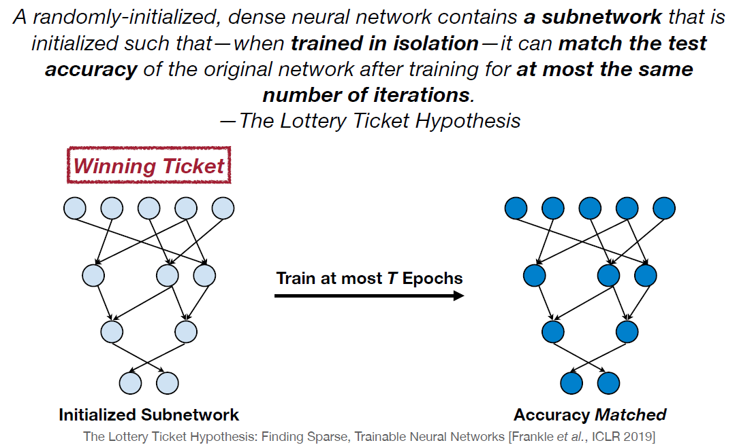
Lottery-Ticket Hypothesis

Slide 38
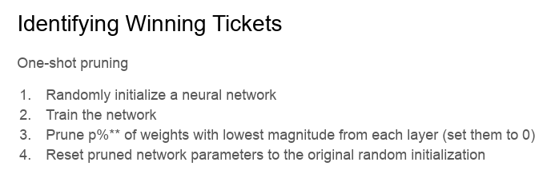
Lottery-Ticket Hypothesis

Slide 39
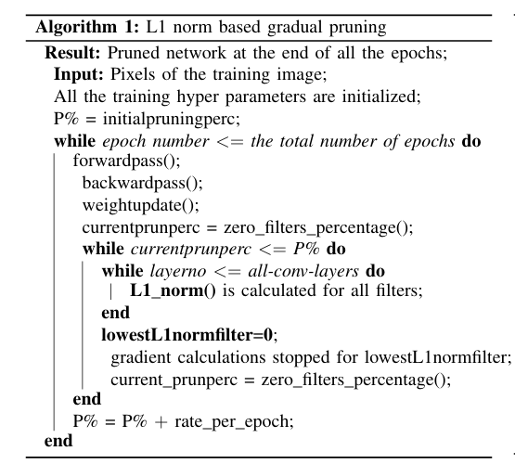
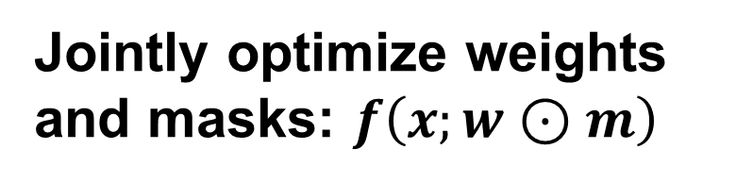
When to Prune
Prune during training
Jointly optimize weights and masks: $f\left(x;w⊙m\right)$
Roy et al. Pruning Filters while Training for Efficiently Optimizing Deep Learning Networks. 2020

Slide 40
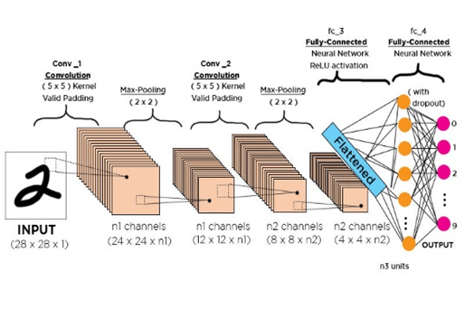
When to Prune
Prune during test time
Y. Tang, Y. Wang, Y. Deng, C. Xu, D. Tao, and C. Xu, “Manifold regularized dynamic network pruning,” in Proc. IEEE Conf. Comput. Vis. Pattern Recognit., 2021, pp. 5018–5028.

Slide 41
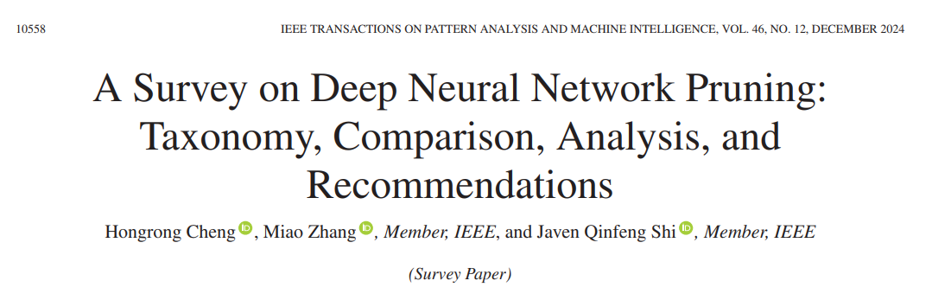
A Survey

